Slide 1
Cryptology (3)
Symmetric Encryption
John York, Blue Ridge Community College
http://www.brcc.edu
Notes:
Much of the information in this course came from “Understanding Cryptography” by Christoff Parr and Jan Pelzl, Springer-Verlag 2010
Much of the classical cryptography material and most Python scripts came from “Cracking Codes with Python” by Al Sweigart, NoStarch Press 2018
Also helpful, “Cryptography Engineering” by Ferguson, Schneier, and Kohno, Wiley Publishing, 2010

Slide 2
Symmetric Encryption Types
Stream Cipher
Encrypt each bit as it is presented
Generate a sequence of bits of the key—key stream
XOR the key stream and plaintext stream (Python XOR operator is ^)
RC4 is stream cipher
Block Cipher
Collect plaintext bits into blocks
Encrypt blocks, commonly 128 bits at present
Most current encryption uses block ciphers
Notes:
Stream ciphers are not in widespread use, at least currently. Network and CPU speeds are high enough that the latency caused by waiting for 128 bits to arrive to be collected into a block is not noticeable.
Block ciphers, especially AES, are the current norm.
The XOR operation is used internally in many cryptographic algorithms and is useful when analyzing cryptography. XOR essentially adds two bits together, except it does not have a carry bit.

Slide 3
More terms—Initialization Vector and Nonce
Initialization Vector (IV)
Unpredictable, or random number added to encryption
Prevents repeated encryption of plaintext from yielding same ciphertext
IV is generally not secret
Like a salt in Linux password hashes
IVs must never be reused—used only once
Nonce
N(umber used) ONCE
Synonym for IV
Notes:
Initialization vectors, nonces and salts (discussed later in hashes) are added for their randomness. Without them, repeated encryption of the same plaintext would result in the same ciphertext every time. An observer may not be able to decrypt the message, but they can glean information from it. If the enemy are attacked at sunrise every time they see a certain message, they can conclude the message means “attack at dawn.”
An IV, nonce, or salt must be random.
Critically, an IV, nonce, or salt can only be used once. Otherwise the entire crypto system could be broken.

Slide 4
Standard Block Ciphers
Data Encryption Standard (DES)
Block size 64 bits, key size 56 bits
Published 1974, broken (brute force) 1997-99, now obsolete
3DES (pronounced triple-DES) NIST calls it 3TDEA
DES three times
Useable today, provided a different key used each time
3 * 56 = 168 bit key, but effective security is 112 bits
Advanced Encryption Standard (AES)
Block size 128 bits, key size 128, 192, or 256 bits
Current NIST standard, approved 2001
Notes:
DES has been broken. The algorithm is fine, but the key size is small enough (56 bits) that modern computers can use brute force attacks against it. It was broken by distributed computing in 1999 and can be broken on a decent PC today. https://en.wikipedia.org/wiki/Data_Encryption_Standard
Triple DES (3DES) is the minimum acceptable encryption approved by NIST, as of January 2016. https://nvlpubs.nist.gov/nistpubs/SpecialPublications/NIST.SP.800-57pt1r4.pdf It consists of running the ciphertext through the DES algorithm three times, with a different key each time. Unlike the Caesar cipher, multiple rounds of DES do improve security.
Note that the key for each of the three rounds must be different.
The effective key length for 3DES is 112 bits instead of 128 bits, due to the “meet in the middle attack.” The attacker can break one round of 56 bits by attacking the left side, and the other two rounds of 56 bits (112) by attacking the right side. They keep doing this until the left and right match, which is much faster than trying to break 128 bits.
Note that in AES, you can choose different key lengths (128, 192, or 256 bits) but the block size never changes. The block size is always 128 bits or 16 bytes.

Slide 5
Block Cipher Goals
Key cannot be computed from ciphertext
Crypto term is confusion
Done with substitution
A 1-bit change in plaintext changes several bits throughout entire block
Crypto term is diffusion
Done with transposition—bit permutation in DES, “Mixcolumn” in AES
Key space is large enough to prevent brute force attacks
Executed quickly in hardware
Executed quickly in software
Notes:
When DES is broken by brute force, the key can be computed. This breaks the first goal.
When a small change in plaintext causes a large and random change in the ciphertext, this prevents attackers from discerning part of the plaintext. For example, consider the message, “Please deposit $100”. If several messages (“Please deposit $110”, please deposit $200”, etc.) are intercepted and only the very end of the ciphertext changes, the attacker will eventually determine that the last digits are the amount.
Key space is roughly analogous to key length, provided the encryption algorithm is good and keys are randomly chosen.. It basically means, “how many times would the attacker have to guess before they break the encryption?” If the key is long, say 0x29533af76, but you only ever use two keys (0x29533af76 and 0x29533af77) the key space is two.

Slide 6
Rounds
Each method (DES, AES, etc.) has an internal algorithm
Algorithm is repeated several times, i.e. rounds
Key is processed so that each round has a different key
DES has 16 rounds
AES
128 bit key has 10 rounds
192 bit key has 12 rounds
256 bit key has 14 rounds
Notes:
The number of rounds is just how many times the internal algorithm is repeated.
It is important to note that the key is manipulated so that each round has a different key. The process of determining the key for a given round is separate from the processing of the message data itself. Usually key processing is done in parallel with the message processing and uses its own algorithm or key schedule.
AES length and rounds, https://en.wikipedia.org/wiki/Advanced_Encryption_Standard

Slide 7
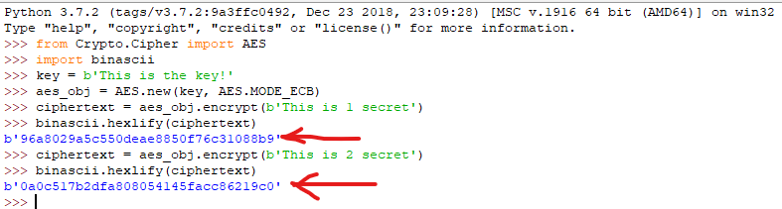
AES Diffusion
Diffusion—changing a single bit of plaintext should change many bits, apparently at random, in the cipher text
Plaintext 1 is “This is 1 secret”, hex 5468 6973 2069 7320 3120 7365 6372 6574
Plaintext 2 is “This is 2 secret”, hex 5468 6973 2069 7320 3220 7365 6372 6574
(using AES ECB mode and no IV, pycryptodome in Python)
Notes:
This example was created using PyCryptodome, Python 3.7 on a Windows VM using Electronic Codebook (ECB) mode in AES. This code also runs in Ubuntu and CentOS. I chose Idle in Windows because I liked the colors.
The ‘b’ in front of the strings tells Python that they are to be stored as byte literals instead of strings. The aes_obj.encrypt() method will throw an error if you submit a string instead of a byte literal. Run type 'abc' and type b'abc' to see the difference.
One of the biggest problems I have in coding ITSec problems is getting the data in the correct type and converting between types. The binascii module is a great help.
Normally if the encrypted data must be mailed, it is converted to base64 instead of hex characters in ASCII. In this case I chose hex (binascii.hexlify) so that it would be easy to see how much the ciphertext changed when one digit of plaintext changed.
The AES module is a ‘primitive.’ It is very picky about the data you submit. The key must be exactly 16, 24, or 32 bytes long (AES 128, AES 192, or AES 256). The data to be encrypted must be a multiple of 16 bytes (128 bits) exactly. Anything different for the key or data will cause an error.

Slide 8



But, it’s more complicated
Problems when encrypting many blocks using same key, and no other changes—Electronic Codebook, or ECB mode
If large blocks of plaintext repeat, so does the cipher text
No diffusion between blocks
Left Image: plaintext
Middle image: blocks encrypted with no feedback between blocks
Right image: properly encrypted
https://en.wikipedia.org/wiki/Block_cipher_mode_of_operation
Notes:
The penguin picture has many 16-byte blocks of data that are all white, all black, or all yellow. With the same key and no changes, all the white blocks have the same ciphertext, as do the all black and all yellow blocks. An attacker can use this to extract information from encrypted traffic.

Slide 9
General Rule
If a block of plaintext is encrypted several times, each block of ciphertext must be different
If a block of plaintext is always encrypted to the same ciphertext, the encryption is vulnerable
The primary reason for having AES modes (other than ECB) is to follow this rule

Slide 10
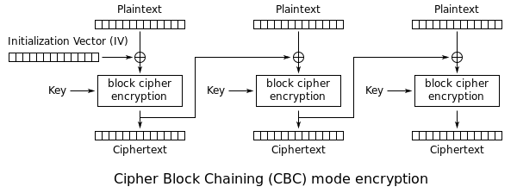
Modes in Block Encryption (a few of many)
Electronic Codebook Mode (ECB)
Method from previous slide—each block is encrypted with same key, independently from other blocks. Identical plaintext produces identical ciphertext
Bad idea
Cipher Block Chaining (CBC)
Plaintext is XOR’d with the ciphertext from the previous block before encryption
Requires picking a random IV to XOR the first block
https://en.wikipedia.org/wiki/Block_cipher_mode_of_operation
Notes:
ECB is not recommended, since identical plaintext blocks produce the same ciphertext. It is nice for simple examples since you don’t have to worry about initialization vectors or nonces, but not good in practice. It has no method for injecting randomness. A one block (128 bits or 16 bytes) message will always be encrypted the same way, if the key is the same.
In Cipher Block Chaining (CBC) the ciphertext from the previous block is XOR’d with the plaintext for the current block. However, the first block of plaintext does not have a previous block to XOR, so it is XOR’d with a random Initialization Vector (IV). The IV must be sent along with the ciphertext so the decryption algorithm knows where to start. The IV itself does not need to be encrypted.
The IV must be random and cannot be reused.

Slide 11
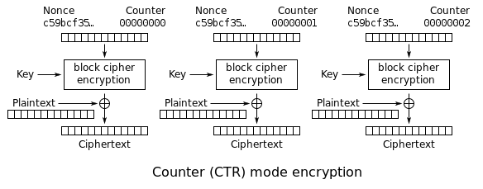
Modes in Block Encryption (2)
Counter Mode (CTR)
Plaintext is XOR’d with a value that changes (may just increment) for each block
Counter starts at random value (Nonce)
https://en.wikipedia.org/wiki/Block_cipher_mode_of_operation
Galois Counter Mode (GCM)
Like CTR, “Galois” comes from multiplication over Galois Field
Adds a Message Authentication Code (MAC) to detect tampering
Notes:
“Cryptography Engineering” by Ferguson, Schneier, and Kohno recommends CBC over CTR because IV/nonce generation is difficult. A not so random nonce or IV has a larger effect on CTR.
Counter Mode (CTR) encrypts a random nonce combined with a counter (the counter often starts at 0), and then XORs the result with the plaintext to get the ciphertext. For each subsequent block, the counter is incremented. This gives the encryption a random start and ensures that each block is encrypted differently.
The Galois Counter Mode (GCM) has an added benefit, in that computation of a Message Authentication Code (MAC) is built in. With CBC and CTR code must be added to include a MAC. Remember the problems that WEP had because it did not include a method to detect an attacker submitting tampered data?
Note: The ‘Galois’ in GCM comes from mathematical operations in a Galois Extended Field. The addition and multiplication operations are redefined. If you enjoy math, you can read more in Paar, pg 90 and pg 134.

Slide 12
AEAD Modes in Block Encryption
Authenticated encryption with associated data (AEAD)
Symmetric encryption needs to protect itself from malicious input
Attackers can create crafted input that reveals details about the encryption
It may be possible for attackers to modify ciphertext to corrupt the plaintext
Some modes create separate authentication codes that are sent along with the ciphertext. The decryption algorithm uses both the cyphertext and the code; it will generate an error if the ciphertext is corrupted.
Some AEAD modes are GCM, CCM, EAX, and SIV
Some modes without authentication are ECB, CTR, and CBC
Notes:
For more information on AEAD, see https://en.wikipedia.org/wiki/Authenticated_encryption
Some of the PyCryptodome modes that include a MAC are GCM, CCM, EAX, and SIV
https://pycryptodome.readthedocs.io/en/latest/src/cipher/modern.html
Some of the pycryptodome modes that do not include a MAC are ECB, CBC, CTR
https://pycryptodome.readthedocs.io/en/latest/src/cipher/classic.html
There are many more block cipher modes than the ones discussed here.
For more information on block cipher modes, see
https://en.wikipedia.org/wiki/Block_cipher_mode_of_operation
https://pycryptodome.readthedocs.io/en/latest/src/cipher/aes.html

Slide 13
Other Notes
Good block ciphers include a nonlinear element
Otherwise if plain and cipher text are known, linear equations can find the key
AES Competition completed in 2001
Winner submitted by Rijndael (pronounced rain-dahl) became AES
Other worthy entries—public domain, so can be used
Twofish
Serpent
MARS
Notes:
The term nonlinear means the same thing as it does in your standard math classes. The equation y = mx + b is linear and is easier to solve than a nonlinear equation like y = x² In a nonlinear function, f(a + b) ≠ f(a) + f(b).
In AES, the nonlinear component is provided by the S-boxes. S(b₀ + b₁) ≠ S(b₀) + S(b₁)
For more information about the NIST competition for AES, see https://en.wikipedia.org/wiki/Advanced_Encryption_Standard_process
Source code for Twofish is available here. https://www.schneier.com/academic/twofish/download.html
Source code for Serpent is available here. https://www.cl.cam.ac.uk/~rja14/serpent.html

Slide 14
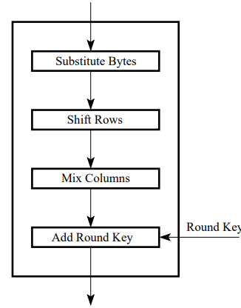
AES Extras (1)
Data being encrypted is 4x4 matrix of bytes
Substitute Bytes
Uses a lookup table (S-box) to change each byte
Designed to be highly non-linear
Shift Rows
Row 1 unshifted, row 2 shift by 1, row 3 by 2, …
Adds some diffusion
Mix Column
Can be thought of as matrix multiplication
Major diffusion element
Add round key
Key is modified to be different each round
XOR with current key
One AES Round
https://engineering.purdue.edu/kak/compsec/NewLectures/Lecture8.pdf
Notes:
The block size of AES is 16 bytes, as in b₀, b₁, b₂, …, b₁₅. Arrange the bytes in a 4x4 matrix
$$\left(\begin{matrix}b0 & b4 & b8 & b12 \\ b1 & b5 & b9 & b13 \\ b2 & b6 & b10 & b14 \\ b3 & b7 & b11 & b15\end{matrix}\right)$$
Substitute bytes uses S-boxes, described later
Shift rows. Shift each row by its row number. Row 0 doesn’t move, row 1 shifts by 1, etc.
$$\left(\begin{matrix}b0 & b4 & b8 & b12 \\ b5 & b9 & b13 & b1 \\ b10 & b14 & b2 & b6 \\ b15 & b3 & b7 & b11\end{matrix}\right)$$
Mix column uses matrix multiplication. However the addition and multiplication operators are Galois field operators, not standard add and multiply.
$$\left(\begin{matrix}C0 \\ C1 \\ C2 \\ C3\end{matrix}\right)= \left(\begin{matrix}02 & 03 & 01 & 01 \\ 01 & 02 & 03 & 01 \\ 01 & 01 & 02 & 03 \\ 03 & 01 & 01 & 02\end{matrix}\right)\left(\begin{matrix}b0 & b4 & b8 & b12 \\ b5 & b9 & b13 & b1 \\ b10 & b14 & b2 & b6 \\ b15 & b3 & b7 & b11\end{matrix}\right)$$

Slide 15
AES Extras (2)
Math behind AES is based on Extended Galois Fields
AES uses 2⁸ elements, not a prime number
Modular multiplication does not always have inverse (remember Affine cipher in Cryptology 2)
Redefines addition, multiplication, and inverse
Treats bits as polynomial coefficients and uses polynomial arithmetic
Polynomial arithmetic was used to create S-box
A person coding AES does not do polynomial arithmetic, just uses S-box.
Notes:
The complicated math (Extended Galois Fields) is used to create the S-box lookup tables, and the S-boxes are coded into the algorithm. For more information about Extended Galois Fields, see Paar pg 93.
In software implementations of AES, the S-box is constructed ahead of time, and it is incorporated into the algorithm as a lookup table.

Slide 16
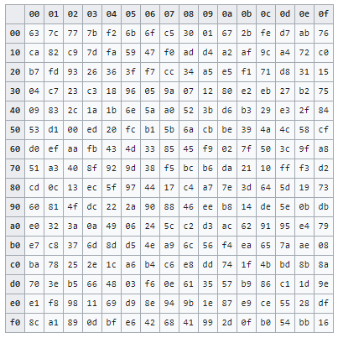
AES Extras (3)
Sample S-box (substitute bytes)
0x4a
Find 40 row, then 0a column
Result is d6
0xa7
Result is 5c
S-box is computed ahead of time, so algorithm does not have to do computations over Galois Fields (GF)
S-box provides substitution and is non-linear
https://en.wikipedia.org/wiki/Rijndael_S-box
Notes:
The Substitution block, or S-box is just a lookup table. A lot of math goes into computing the values in the table, but the table does not change. Therefore developers hard code the S-box and do not have to worry about the math behind it.
The AES algorithm is designed around bytes, and therefore is most efficient on 8-bit computers. It is not as efficient on 32 and 64 bit computers. Often, algorithms for those computers reduce the entire round (except for Add-key) to a lookup table.

Slide 17
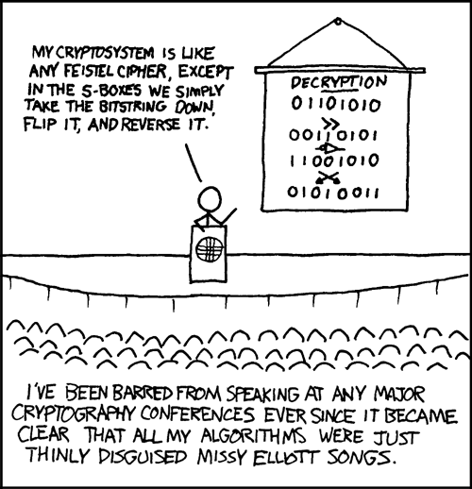
DES is based on the Feistel algorithm, DES and AES both use S-Boxes. Now, make them into a song…
Notes:
I feel obligated to include an XKCD cartoon in every cryptography lesson. In this one, he is just babbling and has been justly excluded from cryptography conferences ;-)

